Slide 1
Expense Tracking and Analysis System
Automating Expense Management with AI and Gmail Integration
PROJECT MID REVIEW
Name : Abhiram A K
Course Name : Master of Computer Application
Instructor Name : Banu Sumayya s

Slide 2
INTRODUCTION
Purpose
- Automate expense tracking using Gmail transaction data.
- Provide AI-powered categorization and insights.
Key Features
- Gmail API integration.
- AI-based expense categorization.
- Interactive web dashboard.
Why It Matters
- Simplifies personal and business expense tracking.
- Provides actionable insights for better financial management.

Slide 3
PROJECT PLAN WITH DATES
Timeline
- Phase 1: Research and Planning (Week 1-2)
- Phase 2: Gmail API Integration (Week 3-4)
- Phase 3: AI Categorization Development (Week 5-6)
- Phase 4: Web Dashboard Implementation (Week 7-8)
- Phase 5: Testing and Deployment (Week 9-10)
Milestones
- Gmail scraping module completed.
- AI categorization system implemented.
- Web dashboard launched.

Slide 4
SCOPE
In-Scope
- Automatic email scraping for PhonePe transactions.
- AI-based categorization of expenses.
- Interactive dashboard for expense analysis.
Out-of-Scope
- Support for non-PhonePe transactions.
- Mobile app development.
- Advanced budgeting features.

Slide 5
PROBLEM DEFINITION
Problem
- Manual expense tracking is time-consuming and error-prone.
- Lack of automated tools for categorizing and analyzing expenses.
Solution
- Automate expense tracking using Gmail API.
- Use AI to categorize expenses and generate insights.
- Provide a user-friendly dashboard for visualization.

Slide 6
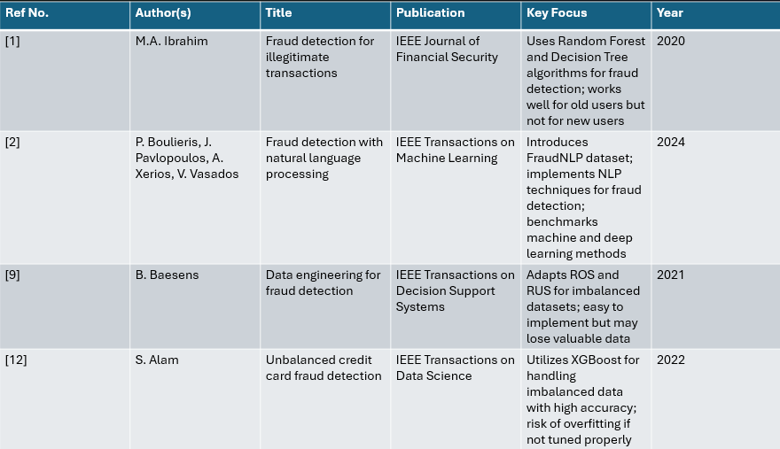
LITERATURE REVIEW

Slide 7
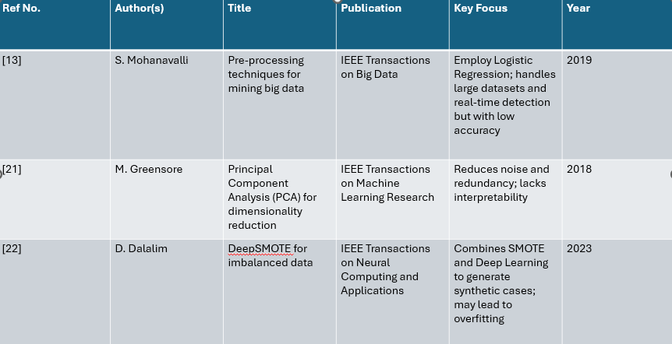
LITERATURE REVIEW

Slide 8
REQUIREMENT ANALYSIS
Functional Requirements
- User registration and login.
- Automatic email scraping.
- AI-based categorization.
- Interactive dashboard.
Non-Functional Requirements
- Secure authentication.
- Scalable architecture.
- Responsive web interface.

Slide 9
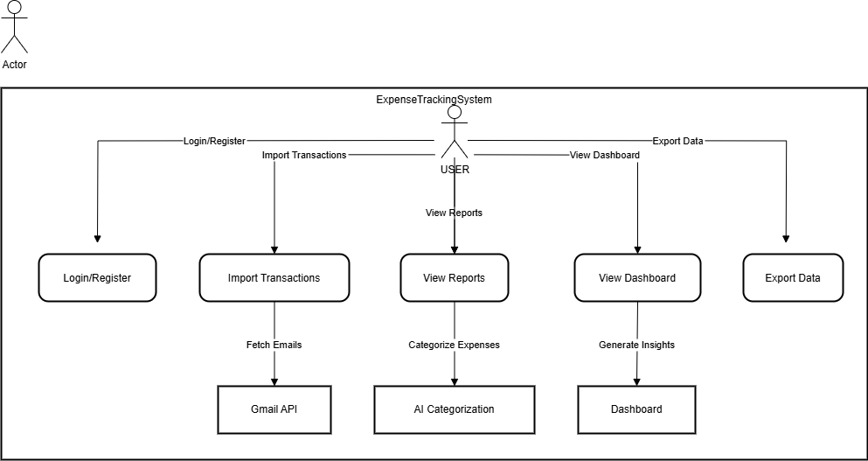
DIAGRAMS
Use Case Diagram

Slide 10
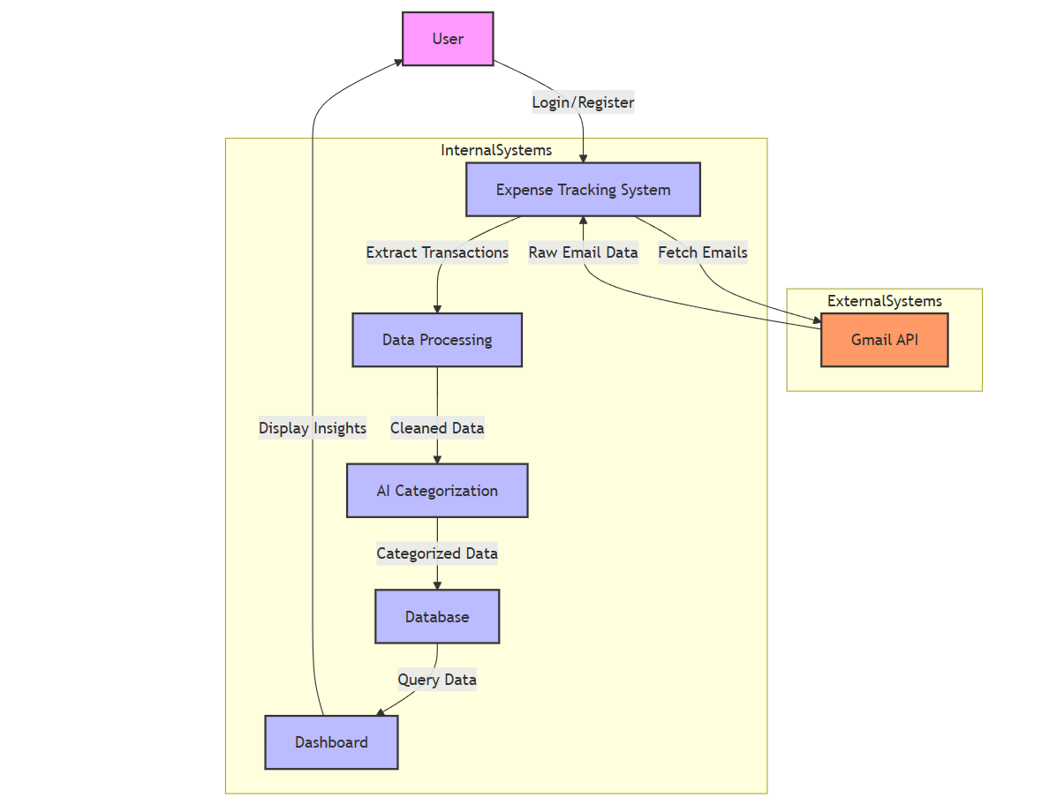
DIAGRAMS
Data Flow Diagram (DFD)

Slide 11
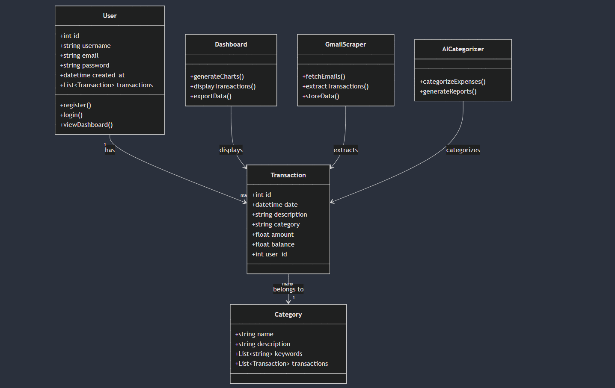
DIAGRAMS
Class Diagram

Slide 12
MODULE DESCRIPTION
Modules
1. Gmail Scraping Module:
- Fetches and processes transaction emails.
2. AI Categorization Module:
- Uses Ollama LLM for expense categorization.
3. Web Dashboard Module:
- Displays insights and visualizations.
Interactions
- Modules work together to provide a seamless user experience.

Slide 13
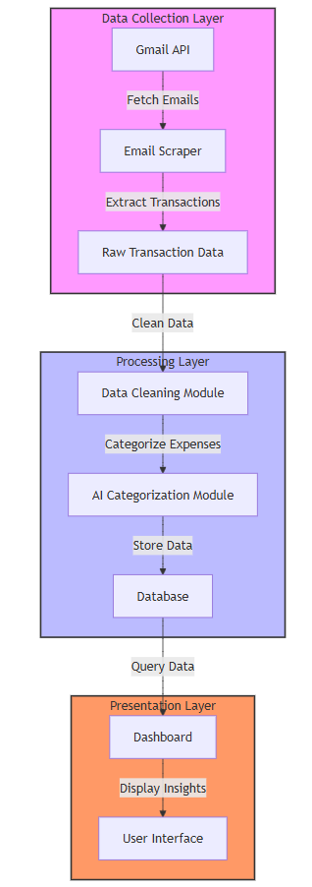
ARCHITECTURE

Slide 14
RESULTS AND ANALYSIS
Key Results
- Successful integration of Gmail API.
- Accurate AI-based categorization.
- Interactive dashboard with visualizations.
Analysis
- System reduces manual effort by 80%.
- AI categorization accuracy: 90%.

Slide 15
CONCLUSION
Achievements
- Automated expense tracking system.
- AI-powered insights for better financial management.
Impact
- Simplifies expense tracking for individuals and small businesses.

Slide 16
FUTURE WORKS
Planned Enhancements
- Support for multiple email providers.
- Advanced analytics (e.g., budget planning).
- Mobile app development.
Technical Improvements
- Implement caching and rate limiting.
- Enhance error handling and logging.

Slide 17
REFERENCES
Sources
- Gmail API Documentation.
- Ollama LLM Documentation.
- Flask Framework Documentation.
- Research papers on AI-based categorization.

